Slide 1

Medical Murder is the #1 Cause of Death in the U.S. – By Design (People Are Too Expensive – Satan’s Big Lie)
When? What Began in the Garden is on Steroids Today

Slide 2

We’ve been programmed to believe lies – from all sides and angles

Slide 3
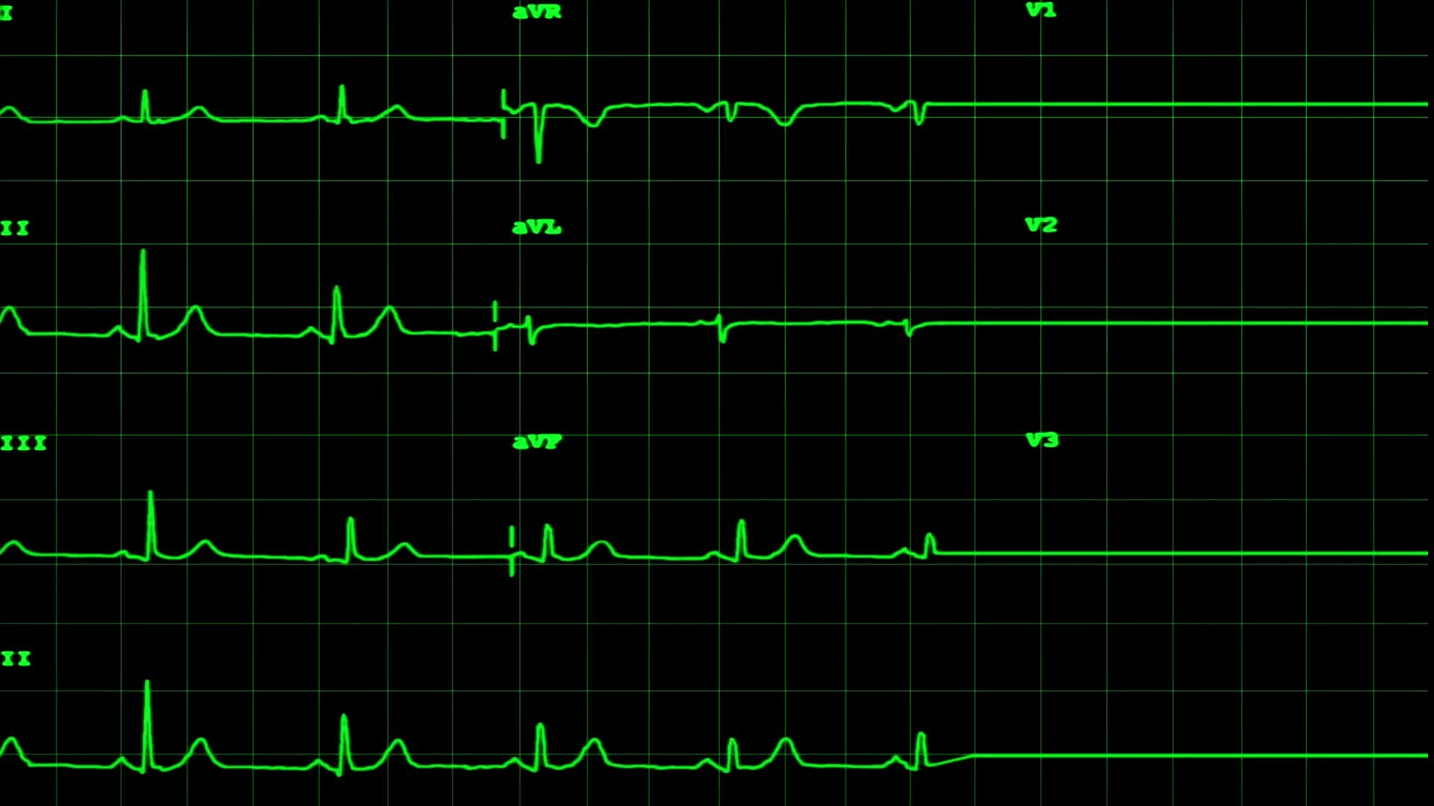
Facts:
Historical facts – pre-COVID
Annual deaths: 700K heart disease; 600K cancer; 400K medical “malpractice” (3rd leading cause of death)
https://www.statnews.com/2021/08/04/medical-errors-accidents-ongoing-preventable-health-threat/#:~:text=Injury%20or%20illness%20caused%20by,under%20wraps%20%E2%80%94%20and%20they%20are
Current facts – COVID Era and Post COVID
All cause mortality increase of 24% in vaccinated
https://www.israelnationalnews.com/news/317091
All cause mortality cumulative increase since January 2020 – weekly graph
https://ourworldindata.org/grapher/cumulative-excess-mortality-p-scores-projected-baseline?tab=chart&facet=none&country=~USA

Slide 4


Introduction to Deceptive Exoteric Strategies

Slide 5

Review: What Does Each Side Offer?
God
Satan
Tree of Knowledge of:
Tree of Life
Evil
Good Less Evil

Slide 6



Satan’s favorite propaganda tool
He uses exoteric dialectics so his real agenda can proceed, unnoticed

Slide 7

What is going on? A 6000-year Second Law of Thermodynamics project in the works. Satan’s first deception – knowledge will make you like God!
What are dialectics?
Dialectics are deceptive tools used to get us thinking about things in an evil vs. less evil paradigm, where both sides ignore God, although they often reference God and being “the light.” The method uses perceived opposing forces meant to deceive us. Dialectics can be either exoteric (easily seen/common) or esoteric (not public/hidden). Satan masterfully uses the Hegelian Dialectic model (problem/reaction/solution) to deceive us to look to man’s ways and ignore God. God’s ways are always outside of these false paradigms. Once we are in the trap, we stop looking to God.
What is going on?
Satan has had a long time to perfect his lies and has sown plenty of them. He had to convince us to that by making knowledge an idol, we would be like God. Knowledge of what? Man and the planet (as we discussed in ‘Why’). Why is there such an ‘increase’ in knowledge today? Satan knows his time is short, so the dialectics have increased; he knows the Bible better than any man.
Why do we so easily fall for these traps?
We’ve been programmed to believe that good triumphs over evil. While that statement is true, only God is good. Satan has tricked us to believe ‘less evil’ is good, and man by nature is good. He first did this in the garden as recorded in Genesis 3:5, “For God knows that when you eat from it your eyes will be opened, and you will be like God, knowing good and evil.”
We can’t blame the programming. Our sinful nature to be like God was exposed in the garden and is part of each of our desires. We want to be like God versus submitting to Him. Satan offered the Tree of Knowledge as the path to be like God. God offered wisdom – the Tree of Life; Jesus is the Truth and the only path to the Father. The pursuit of knowledge has become an idol and a barrier to the Truth.

Slide 8


What does God say about these traps?
Daniel 12:4
But you, Daniel, keep this prophecy a secret; seal up the book until the time of the end, when many will rush here and there, and knowledge will increase.
2 Timothy 4:3 – 4
For the time will come when people will not put up with sound doctrine. Instead, to suit their own desires, they will gather around them a great number of teachers to say what their itching ears want to hear. They will turn their ears away from the truth and turn aside to myths.
Matthew 7:15-18
Watch out for false prophets. They come to you in sheep’s clothing, but inwardly they are ferocious wolves. By their fruit you will recognize them. Do people pick grapes from thornbushes, or figs from thistles? Likewise, every good tree bears good fruit, but a bad tree bears bad fruit. A good tree cannot bear bad fruit, and a bad tree cannot bear good fruit.

Slide 9


We’ve Been Programmed – All Based on One Lie!
Tree of Knowledge
Genesis 3:15: For God knows that when you
eat from it your eyes will be opened, and
you will be like God, knowing “good” and evil.
Evil vs. Less Evil
Knowledge/Education
Cleverness is key to success in the world
Tree of Life
John 15:5: Apart from Me, you can do
nothing.
Good
Wisdom/Revelation
Humbleness is key to success in the kingdom

Slide 10
Some Examples… Alexandra describes the importance of understanding Satan’s game (the matrix) well: https://www.bitchute.com/video/gXZIJPrw2ISr/
Liberal/Conservative – dialectic = believe government saves
CNN/Newsmax – dialectic = believe truth comes from media
Woman’s right to choose/no abortion, except for … – dialectic = believe murder is okay
Of course, these debates are all part of larger agendas, that are disguised by these smaller traps - which we’ll see coming up

Slide 11
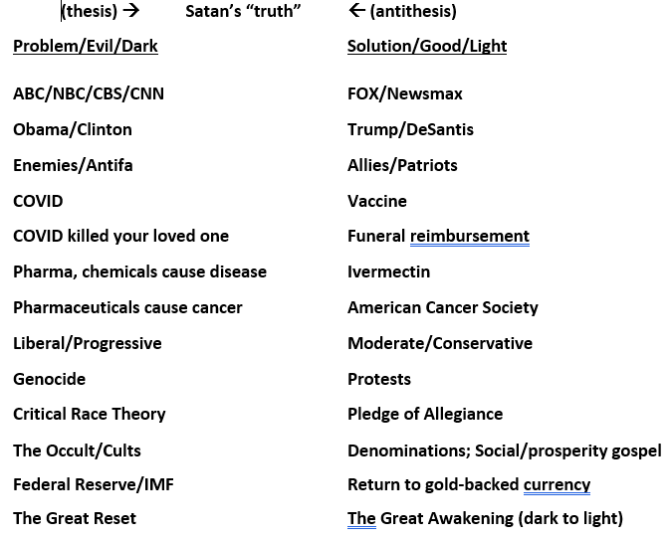
More…

Slide 12
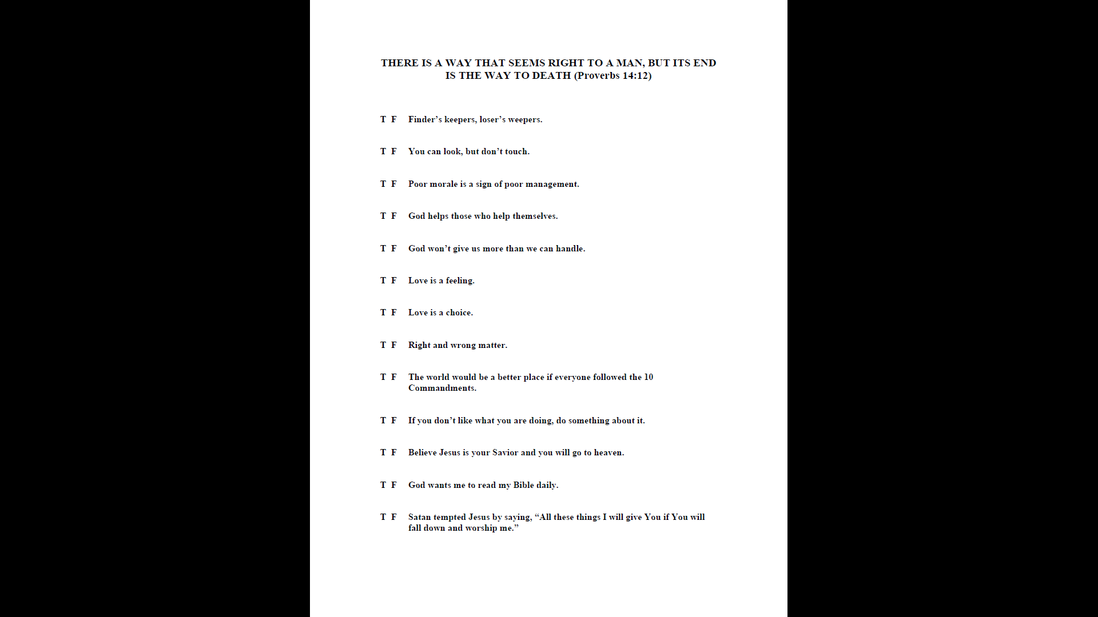
A quiz – What do you believe? Beliefs motivate all actions!

Slide 13
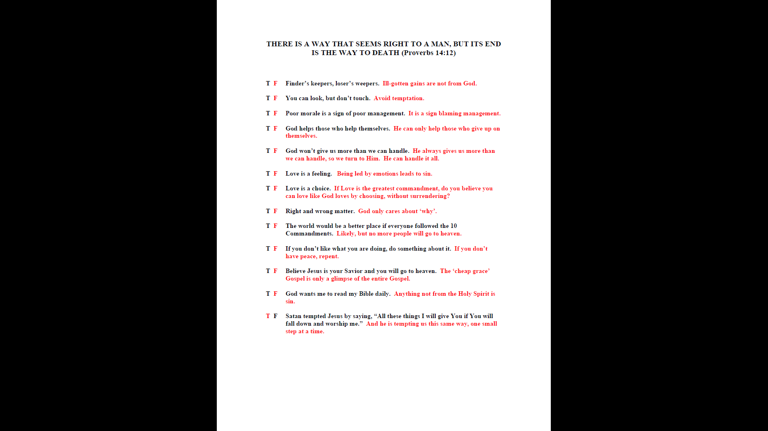

Slide 14
Conclusion: Our desire for knowledge makes us easy targets of deception. Grounded beliefs are essential to guard us against the enemy’s tactics.

Slide 15

A Much Larger Satanic Picture

Slide 16

Some background…
Satan attempts to imitate God. The anti-Christ system tricks us to obeying by focusing on our choice with the goal of the security and comfort false prophet system for those who obey and survive.
God doesn’t control or use fear to motivate. He offers salvation freely and those who accept obey out of a heart change. God sanctifies us through obedience producing freedom, joy and peace. In Satan’s system, the illusion of freedom, combined with fear, produces obedience resulting in slavery.

Slide 17
Did God Really Say…
Satan, the original inventor of propaganda: “Did God really say?” Was the first line of propaganda (Genesis 3:1)
You must not eat fruit from the tree that is in the middle of the garden, and you must not touch it, or you will die (Genesis 3:3)? Led to pursuit of knowledge dialectic and moral relativism, which was necessary for man’s quest to be like God (you can’t trust God)
Be fruitful and multiply (Genesis 1:28)? Led to dialectic of managing people and planet we are experiencing today, which was necessary for the anti-Christ system to take root (you can’t trust God)
Only the Father knows (Mark 3:32)? Led to focus on eschatology dialectics of the church, which leads to lukewarm teaching of Romans 13 and 14, leading to being led astray by the false prophet system (you can’t trust God)
All have sinned (Romans 3:23)? Led to the dialectic that man is inherently good, which was necessary to be able to accomplish the evil agenda right in front of our eyes (you can’t believe God)
He created everything in and on Earth in six days (Genesis 1:3 – 31)? Led to evolution dialectic, which results in no accountability to the Creator (God doesn’t exist)

Slide 18
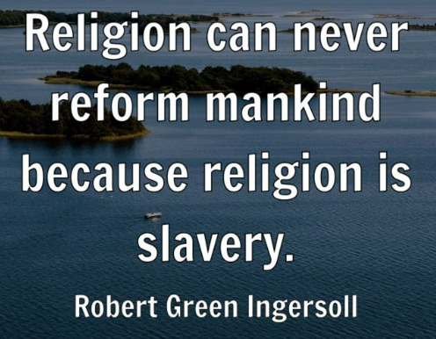
Satan preys on our desire for self-rule. The anti-Christ beast system has three major exoteric components (traps): law and religion to control and money to motivate. We have been deceived to believe that by following these three tricks, we’ll obtain security and comfort. The second beast is the false prophet giving the illusion of providing this exchange, substituting for the Great Exchange – a bad trade (dime for nickel trick).
Jesus was the most anti-religious person to ever walk this Earth – Faith is opposite of religion
What does God say about each?
Money: For the love of money is the root of all evil (1 Timothy 6:10)
Law: For whoever keeps the whole law and yet stumbles at just one point is guilty of breaking all of it (James 2:10)
Religion: These people honor me with their lips, but their hearts are far from me. They worship me in vain; their teachings are merely human rules (Matthew 15:8-9)
Security and comfort: You shall have no other gods before me (Exodus 20:1)

Slide 19

The Temptation of the Beast Systems is Constantly at our Doorstep
Vaccines are a PSYOP showing all 4 elements:
Love of money – incentivized physicians to kill or lose their paycheck
Law – physicians kill or lose their license if don’t follow standards of care; die by the law – will be held accountable by God; fear of lawsuit if patient dies by recommending anything other than government protocols
Religion – vaccines save us; standards of care save us
Security and comfort – childhood vaccines allow me to have a comfortable life, allowing the public fool system to raise and indoctrinate my children

Slide 20
Conclusion: Our desire for our own way opens the door to all kinds of deception.

Slide 21

Dialectics within dialectics

Slide 22
COVID PSYOP proved medical murder was by design
The COVID Dialectic
We keep chasing the evil because we can’t accept this was the goal, both exoterically (to keep us focused on COVID) and esoterically (to have us chase and expose evil, to set up the “solution”)

Slide 23
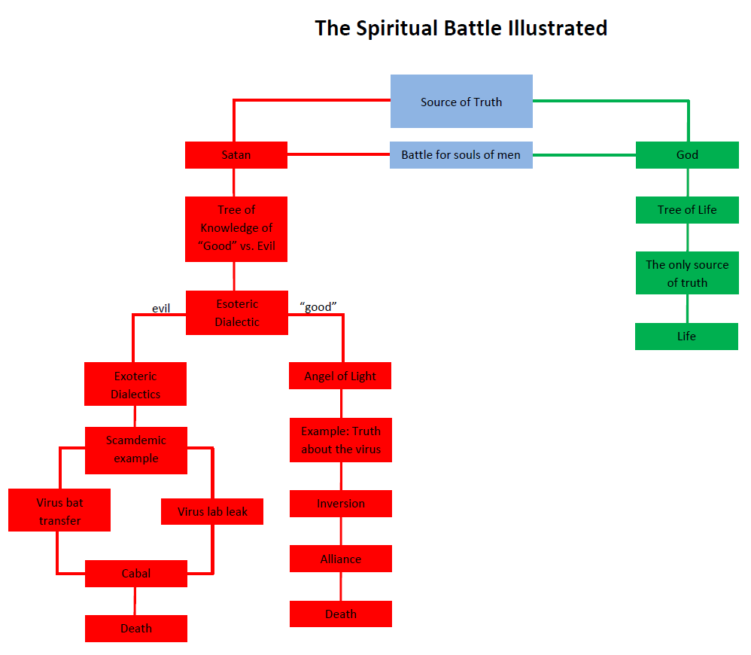
An Illustration
Remember, the exoteric dialectics, like COVID, fit into the larger esoteric dialectic
The setup: Problem = Evil; Reaction = Fear; Solution = Security and Comfort…Order out of Chaos

Slide 24
I Can’t Seem to Get Out of the Game!
Since we can’t believe the results we are seeing was the goal, so go to the next dialectic – let’s use the same anti-Christ legal system to hold them accountable!
Laws protect their own kind, but not you
They can legally kill us
https://rumble.com/v26luvm-the-government-can-legally-kill-us-the-second-largest-psyop-in-the-past-120.html
Since the anti-Christ legal system at best bleeds you dry and takes years while people continue to be murdered, you finally chase changing laws in the anti-Christ legislative system - let’s elect better men to represent us!
Elections – if our country has been sold, is this a viable option?
Fraudulent elections were the goal to get us trapped into fighting to bring election integrity

Slide 25
Conclusion: Satan has the long view in play and knows the Second Law of Thermodynamics (Faith becomes religion; Grace becomes legalism; God is on the throne becomes man can do anything). If we don’t protect our Godly positions, they erode: Order to disorder – the slippery slope. We have become the boiling frog – 6000 years in the making. Disorder/chaos is part of the plan; this way Satan can look like a savior, bringing the ‘less evil’ angel of light to restore order. Power back to the people sounds great, but is the last piece needed to snap the complete control grid into place. When will we realize we can’t win in this rigged game?
P.S. How about starting a war to really stir the pot?

Slide 26

Has God finally had enough of this?

Slide 27

Just a historical phase?
The rise and fall of civilizations:
1. Bondage to spiritual growth
2. Spiritual growth to great courage
3. Courage to liberty
4. Liberty to abundance
5. Abundance to complacency
6. Complacency to apathy
7. Apathy to dependence
8. Dependence back to bondage

Slide 28

Most people don't realize what's happening
Why this time is different than WWII, or other times in modern history? The Spirit of the Age (lovers of self; form of godliness; willingly forget; devote themselves to doctrines of demons; a lot of different movements) is the #1 indicator of the lateness of the hour; for this reason, God sends them a powerful delusion…
https://youtu.be/wLFGRTg4vVg?si=43PSpoKLO5hFPf7-

Slide 29
Conclusion: We accept dialectics because we have rejected God. God is judging America. We keep participating in Satan’s system, blind to the reality that we are in the days of Noah. “For this reason God sends them a powerful delusion so that they will believe the lie and so that all will be condemned who have not believed the truth but have delighted in wickedness.” (2 Thessalonians 2:11 – 12) Will you make the choice to submit to God and get out of the game before it’s too late?

Slide 30
Medical Murder is the #1 Cause of Death in the U.S. – By Design (People Are Too Expensive – Satan’s Big Lie) Up Next…
How? The American Dream

